Slide 1
URL Analyser
Sprint 1 Presentation
Nidhi Tiwari and Arshitha Basavaraj
https://github.com/Arshitha/EC500-Building-Software/tree/testing

Slide 2
Our Objective is twofold:
To pull URLs being visited on a browser through a chrome extension and carry out analysis on various parameters on it.
Example: Webpage content, location of the host company, date of origin of the page, proportion of advertisements on the page

Slide 3
After the analysis is carried out, we will collect this information and create a webpage that will visualise the content based on the parameters listed above that will give the user insight into the qualitative aspects of his internet surfing.
The chrome extension drop down will give the details on the particular website being visited.

Slide 4
User Stories:
The user can get more insight into the quality of surfing and the proportion of time spent on looking at a particular category of information.
The user can get more knowledge about certain qualitative attributes about the websites he is visiting. It may have a bearing in the way in which the user assimilates the information he is viewing.
The user can adjust his surfing style towards a more enhanced, informative and less wasteful surfing experience.

Slide 5
Implementation:
Authentication: Google (Firebase)
Database: MongoDB
Backend: Node.js
Front End: HTML/CSS, Javascript
Why chrome extension?

Slide 6
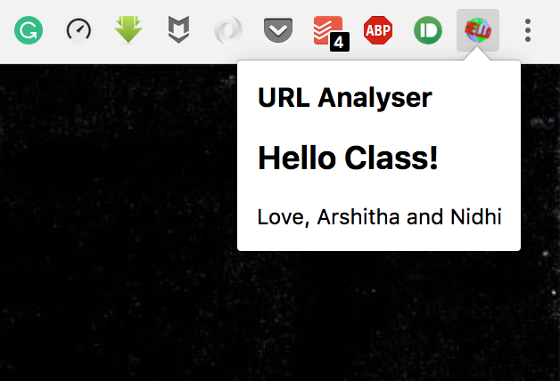
Sprint 1 progress:
Research
User Stories defined
Chrome extension set up (to get started)

Slide 7
How Osama surfs
ICON
PARAMETER TABS:
For visualisations on different parameters.
LANDING PAGE:
Table Containing content categories and proportion of each content during 24 hours of surfing time.
Category | Active Time | % of total time
Work | 12 min 15 s | 8%
Learning | 1 hr | 85%
Social | 25 min 56s | 11%
News | 5 mins | 1%

Slide 8
Sprint 2:
Set up the chrome extension with authentication and database with user information
Content scraping
Extracting information related to domain host company, date of creation, date of recent update

Slide 9
Sprint 3:
Visualizing the data extracted
Landing page for detailed view
Extension drop down for current URL

Slide 10
Thank You! See you in the next Sprint!

